Slide 1

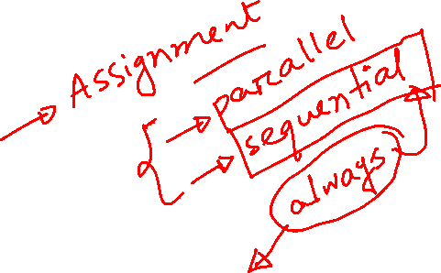
CSE 460: VLSI Design Lab Experiment 2 (Blocking and Non-blocing Statements in Verilog)

Slide 2
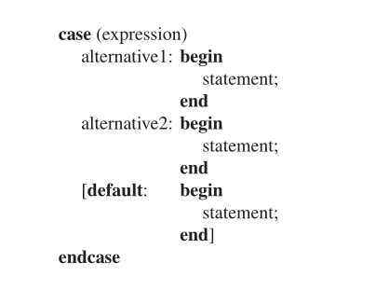
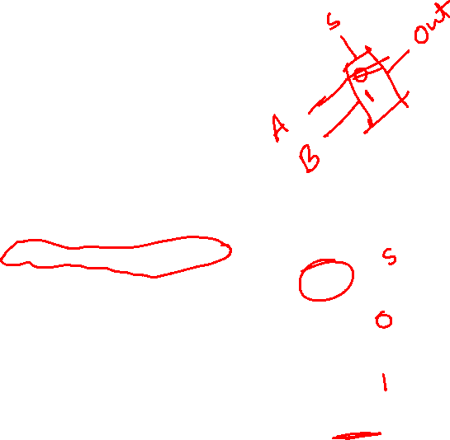
Procedural Statements
We learnt about “If Else” procedural statement in lab lecture 1.
This lecture we will learn about 2nd type procedural statement, the case statement.
The bits in expression are called the controlling expression.
Controlling expression are checked for a match with each alternative.
The first successful match causes the associated statements to be evaluated.
Default case evaluates only when no other alternative matches.

Slide 3
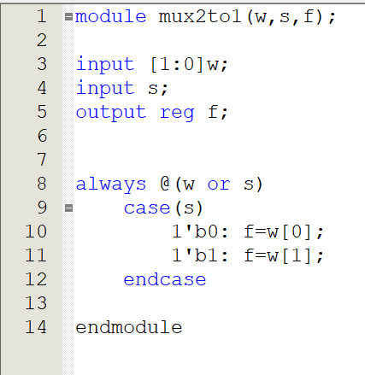
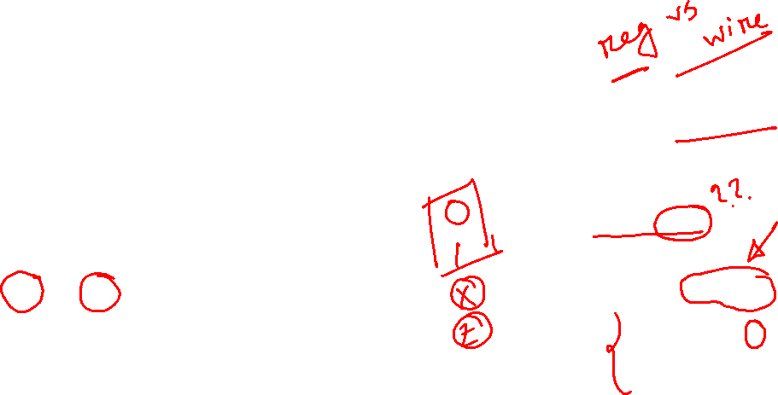
Procedural Statements
This is the code of 2 to 1 Mux using case statement.
The mux can have two possible outputs because “s” is only 1 bit.
Which is why the case statement has two alternatives.
We could have included a default case because “s” can also have values of “x” and “z”. But we will learn about them soon.
We can also use “1” as alternative instead of “1’b0”.
If a statement in an alternative has multiple line it must be included in Begin-end block.

Slide 4
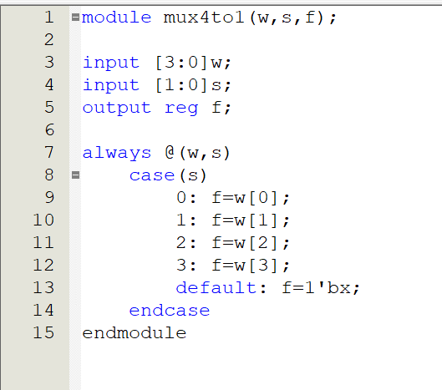
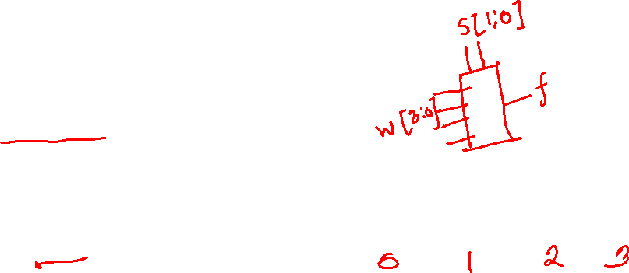
Procedural Statements
S | 00 | 01 | 10 | 11
f | W[0] | W[1] | W[2] | W[3]

Slide 5
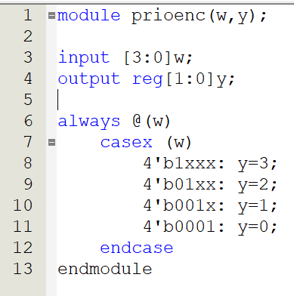
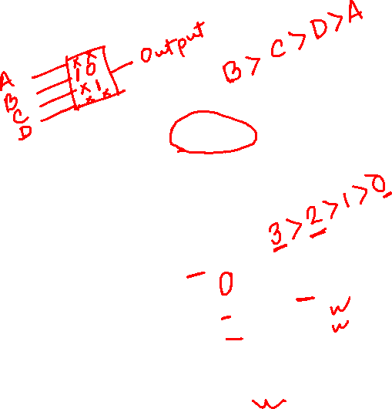
Procedural Statements
In the “case” statement , controlling bits can also have value of “x” and “z”.
The values of “x” and “z” are also checked for exact match with the same values in the controlling expressions.
The “casex” statement treats both “x” and “z” as don’t cares.
That means when they are present as input , code won’t check for their alternatives.
In the right there is a Verilog code of priority encoder with 4 bit input “w” and output “y”.
The first alternative “1xxx” specifies that if w[3] has the value of 1 , then the other inputs are treated as don’t cares and so the output is set to “y=3”

Slide 6

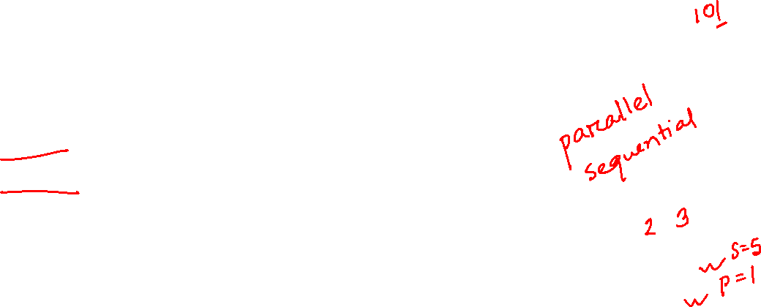
Procedural Assignment Statements
A value is assigned to a variable with a procedural assignment statement.
There are two kinds of assignment statements.
Blocking assignments
Non-blocking assignments.
Blocking assignments are denoted by the “=“ symbol.
Blocking means that first the assignment statement completes and updates it’s left-hand side first.
This updated left-hand side value is then used for evaluation of subsequent statements.

Slide 7
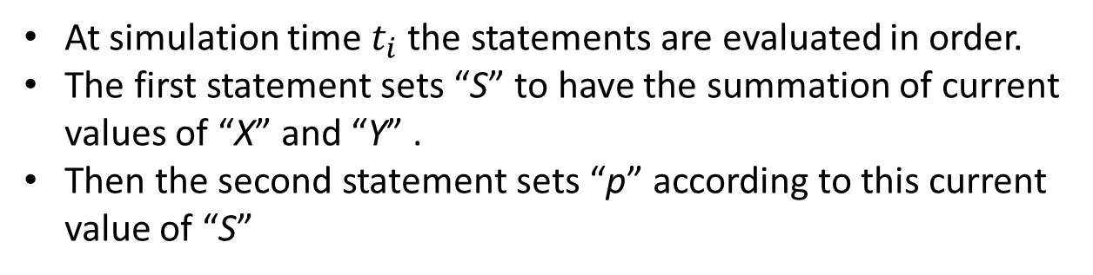

Procedural Assignment Statements
At simulation time $t_{i}$the statements are evaluated in order.
The first statement sets “S” to have the summation of current values of “X” and “Y” .
Then the second statement sets “p” according to this current value of “S”

Slide 8

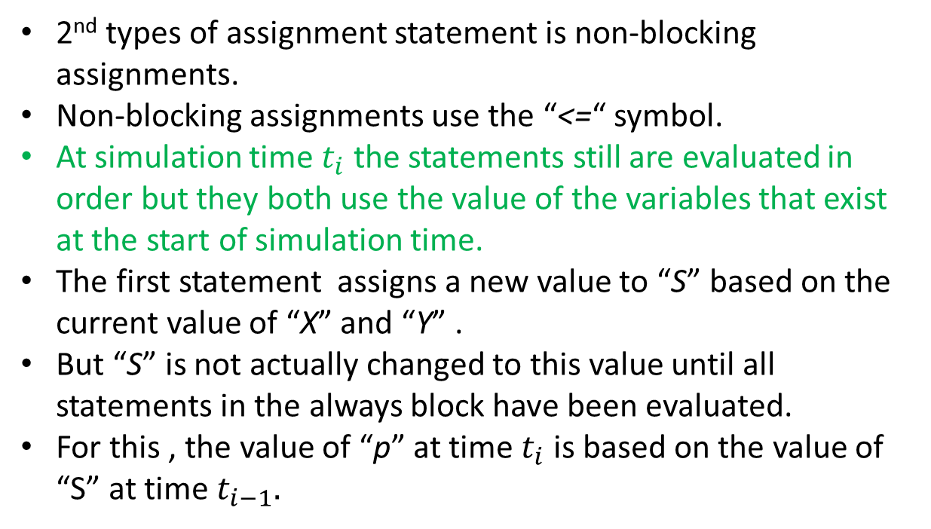
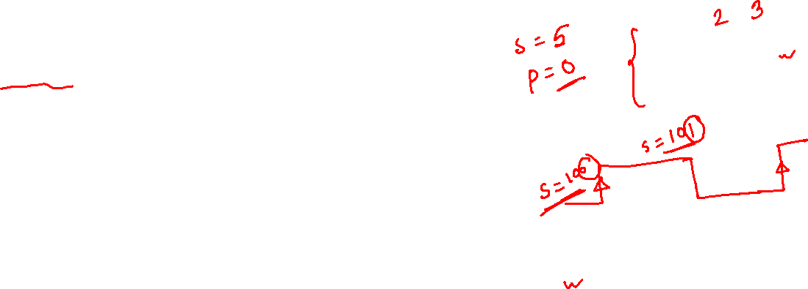
Procedural Assignment Statements
2nd types of assignment statement is non-blocking assignments.
Non-blocking assignments use the “<=“ symbol.
At simulation time $t_{i}$ the statements still are evaluated in order but they both use the value of the variables that exist at the start of simulation time.
The first statement assigns a new value to “S” based on the current value of “X” and “Y” .
But “S” is not actually changed to this value until all statements in the always block have been evaluated.
For this , the value of “p” at time $t_{i}$ is based on the value of “S” at time $t_{i−1}.$

Slide 9
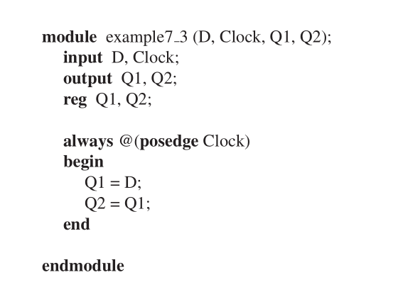
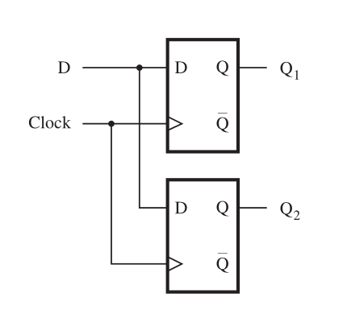
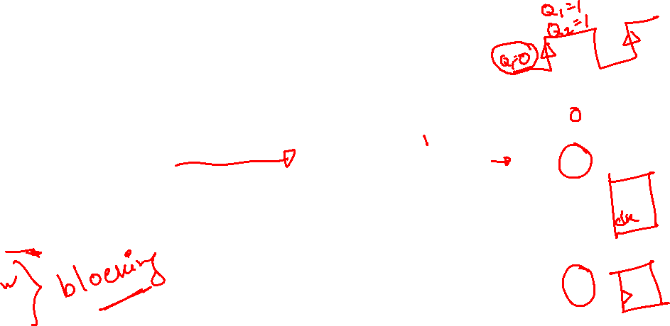
Procedural Assignment Statements

Slide 10
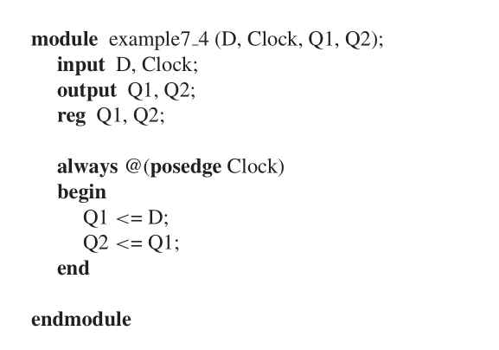
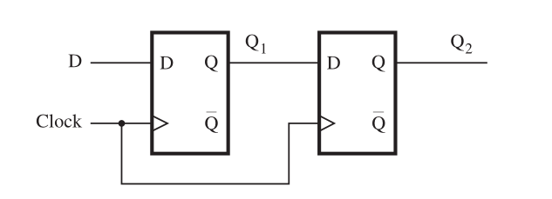
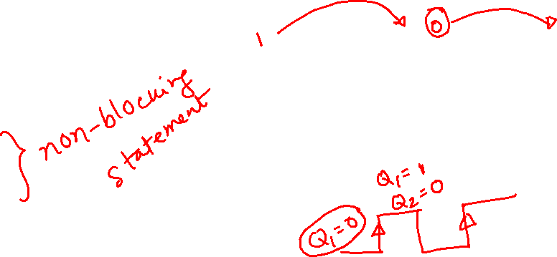
Procedural Assignment Statements

Slide 11
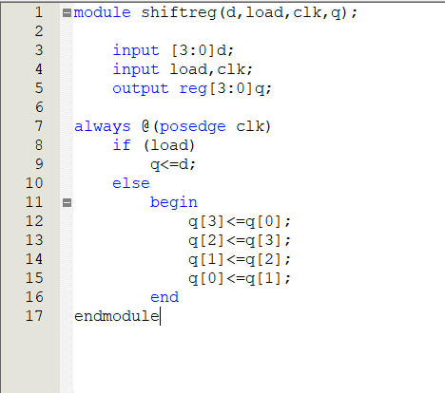
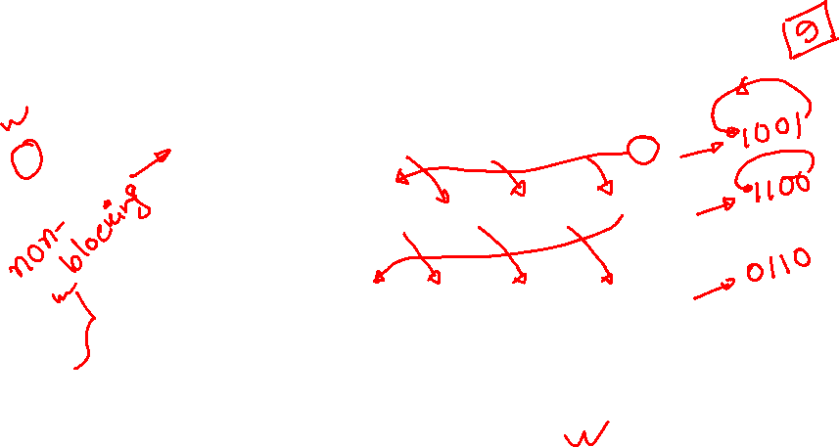
Procedural Assignment Statements
 | q[3] | q[2] | q[1] | q[0]
initial | 1 | 0 | 0 | 1
1st cycle | 1 | 1 | 0 | 0
2nd cycle | 0 | 1 | 1 | 0
3rd cycle | 0 | 0 | 1 | 1
4th cycle | 1 | 0 | 0 | 1

Slide 12
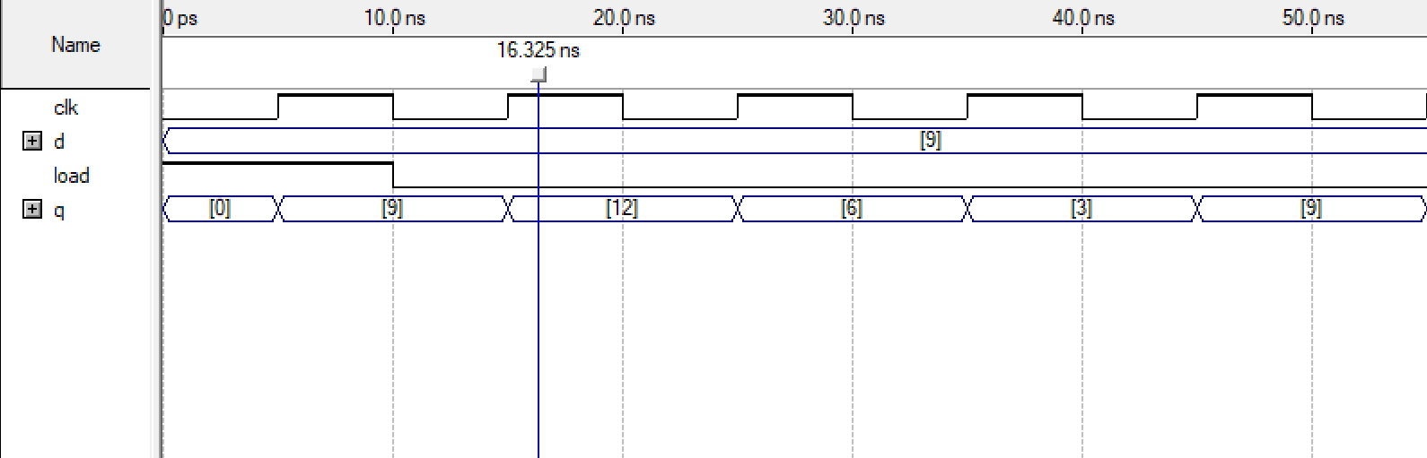
Procedural Assignment Statements (Non-Blocking)

Slide 13
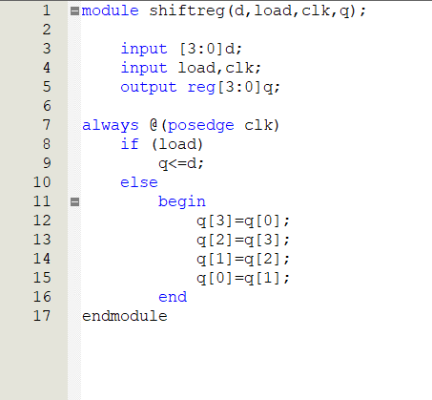
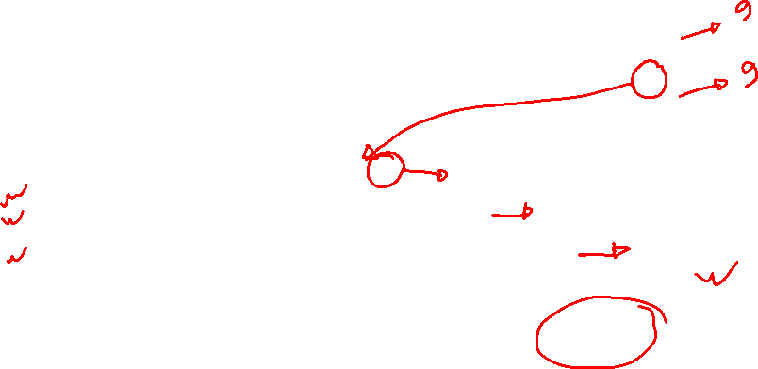
Procedural Assignment Statements
 | q[3] | q[2] | q[1] | q[0]
initial | 1 | 0 | 0 | 1
1st statement | 1 | 0 | 0 | 1
2nd statement | 1 | 1 | 0 | 1
3rd statement | 1 | 1 | 1 | 1
4th statement | 1 | 1 | 1 | 1
All of these happened within one cycle!

Slide 14
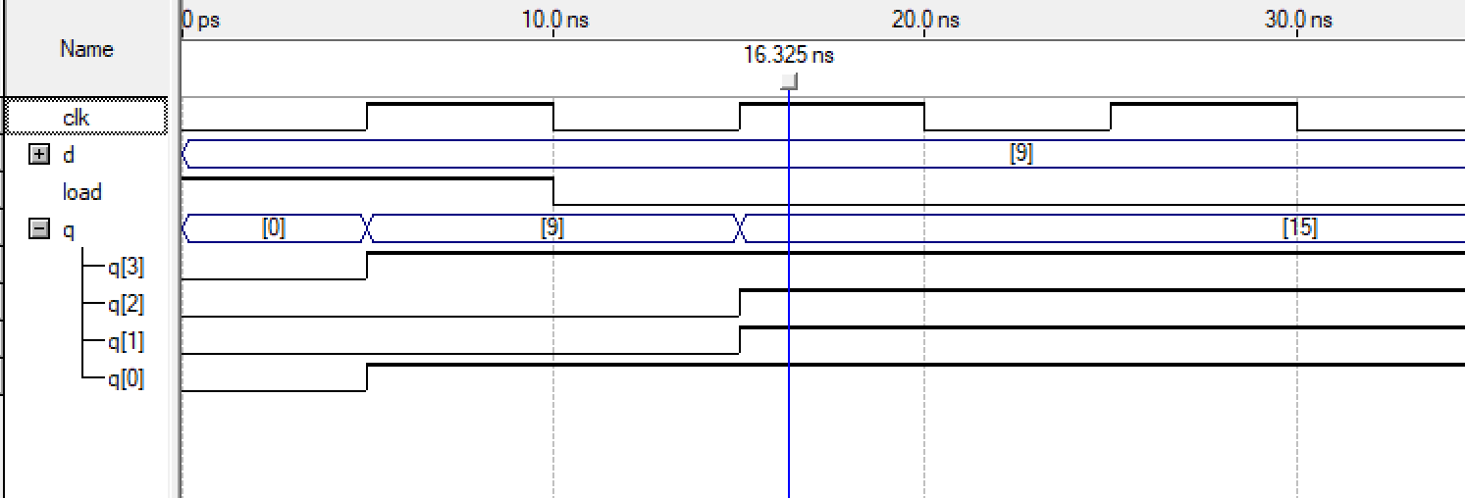
Procedural Assignment Statements (Blocking)

Slide 15
Thank you!

